Slide 1

Serverless vs Containers
Mark Allan (@MarkXA) Azure MVP

Slide 2
Agenda
Services
Containers
Serverless
KEDA
Futures

Slide 3
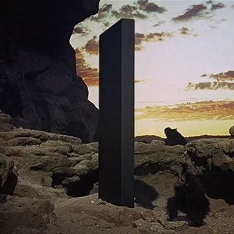
In the beginning

Slide 4
Microservices
Individually deployable and scalable components
Email service
Website
Ad service
Payment service
Checkout service
Cart service
Shipping service
Recommendation service
Currency service
Catalogue service
Notes:
Communication via simple API calls or using some sort of messaging system, for example Service Bus.
And why?
Loose coupling provides resilience
Flexibility to use the best tool for the job, e.g. recommendation service uses AI and needs a Python library
Reusability of services across different projects
Particularly applicable to cloud – efficient scalability e.g. catalogue service vs shipping service

Slide 5

Containers
Your application and all its dependencies
Exactly the same in production as in dev
Connected via network endpoints
Transient - volumes / cloud storage
Sort of like a very lightweight VM
Notes:
Slow adoption in the Microsoft sphere - .NET framework requires Windows, and Windows containers are late to the game and poorly supported.
But with .NET Core and the maturing of Windows containers, now very quickly gaining popularity.
Layers - OS, runtime, build components, other dependencies, finally your code

Slide 6

Kubernetes
Worker node
Kubelet
cAdvisor
Proxy
Pod
Pod
Pod
Master node
API
Service
Scheduler
Worker node
Service
Controller
Manager
Kubelet
cAdvisor
Proxy
Pod
Pod
Pod

Slide 7
DEMO (Wee bit)

Slide 8
API driven
Order
Shipping
Print label
Inventory

Slide 9
Event driven
Order
Order received
Queue
Shipping
Print label
Inventory
Notes:
High throughput, more resilient.

Slide 10

Functions as a Service
Just code running on an abstracted platform
Ephemeral and event driven
Low management, low cost, high flexibility
Local runtime available
Notes:
New hotness. Gave rise to the term “serverless”.

Slide 11

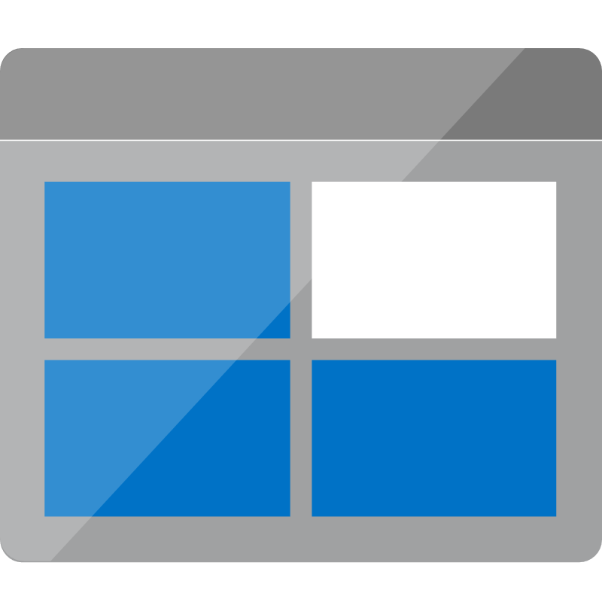
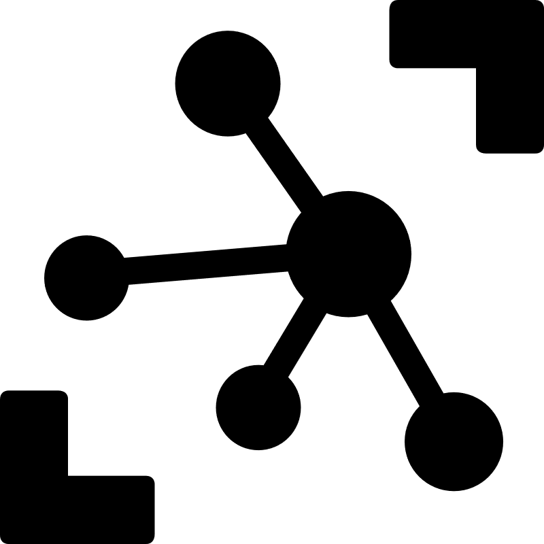



Notes:
“Function” is exactly what it says on the tin.
Event driven workflow architecture.
Example - IoT devices send messages to IoT Hub, functions get triggered to process the messages and write updates to Cosmos, change feed triggers more functions for saving to storage, sending notifications via Notification Hub, or sending messages to Service Bus for further processing.

Slide 12
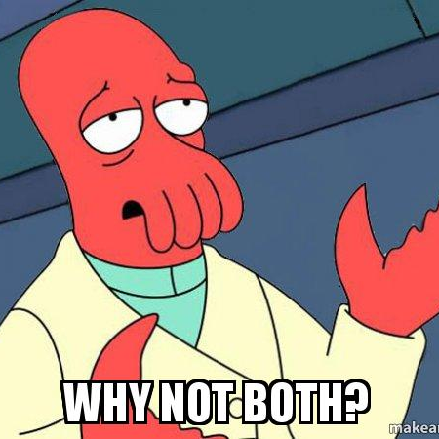
Containers and K8s or FaaS?

Slide 13
Virtual Nodes
Worker node
Kubelet
cAdvisor
Proxy
Pod
Pod
Pod
Master node
API
Service
Scheduler
Worker node
Service
Controller
Manager
Kubelet
cAdvisor
Proxy
Pod
Pod
Pod

Slide 14
Horizontal Pod Autoscaler
HPA
Metrics
Deployment
Pods

Slide 15
KEDA
Kubernetes Event-Driven Autoscaling
https://github.com/kedacore/keda
Microsoft + Red Hat

Slide 16
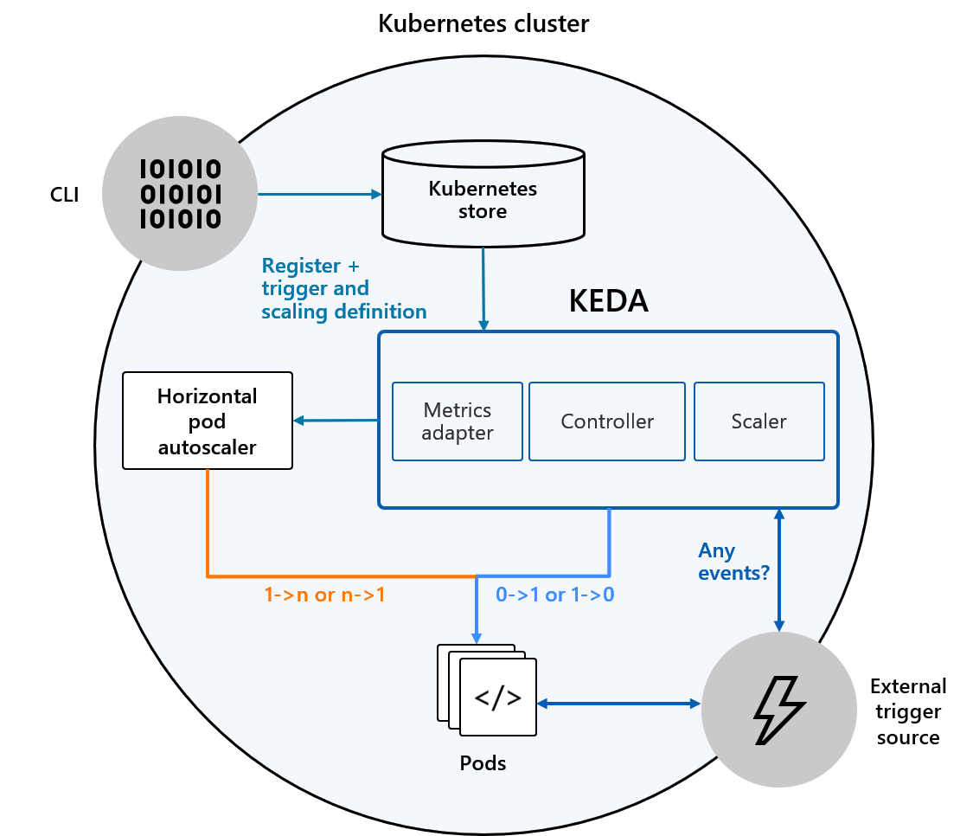
How it works

Slide 17
MOAR DEMO

Slide 18

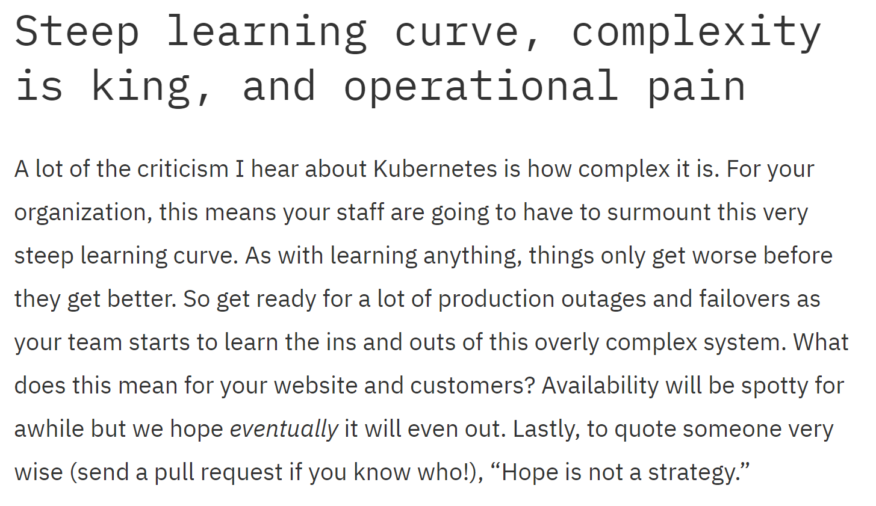
https://blog.jessfraz.com/post/the-business-executives-guide-to-kubernetes/

Slide 19

Blue sky thinking

Slide 20
Resources
https://github.com/kedacore/keda
https://github.com/MarkXA/keda-demo
Me:
https://linkedin.com/in/MarkXA
https://twitter.com/MarkXA
markxa@markxa.com

Slide 21


